Slide 1
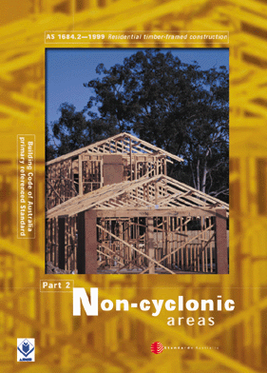
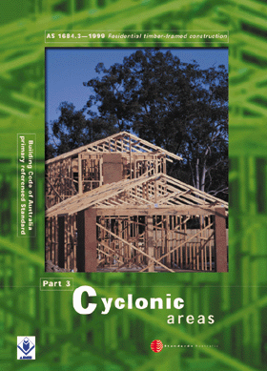
SECTION 5 -
FLOORING

Slide 2
5.1 SCOPE
This Section specifies the requirements for the installation of tongued and grooved strip flooring as well as plywood and particleboard sheet flooring.
NOTE: Appendix F provides guidelines on moisture content of timber flooring

Slide 3
4.1.2 Materials
Any timber species may be used for floor framing, provided it is kept dry; that is, not exposed to weather, well ventilated, not in contact with or close to the ground (see Clause 1.10 and Clause 3.3).
When constructing floors that are exposed to the weather (decks, verandahs), attention shall be given to the durability of materials and detailing required to ensure an adequate service life (see Clause 1.10).

Slide 4
5.2 PLATFORM FLOORS
Where platform floor construction is used, the flooring shall be protected from wetting by rain and wet trades.
NOTE: During construction, all flooring should be flood-coated with a water repellent sealer.

Slide 5
This method provides a working platform for the builder with the floor being laid prior to the erection of wall and roof framing.
This method is not recommended for feature floors as the flooring is exposed to the weather during construction.
It is difficult to adequately protect a platform floor, and degrade due to the effects of sunlight, wetting or work practices may occur.

Slide 6
If the platform floor construction method is used for feature floors, the builder must accept the associated risks.
Manufacturers or suppliers of flooring products may not take responsibility for problems arising as a consequence of weather exposure.

Slide 7
5.3 FITTED FLOORS (CUT-IN FLOORS)
Fitted floors (cut-in floors) are installed after walls have been erected, and after roofing, wall cladding, doors and windows have been installed. Where boards are laid parallel with walls, a minimum 10 mm gap shall be provided between the board adjacent to the bottom plate and the bottom plate (see Figure 5.1).
This method is strongly recommended for the construction of feature floors (polished floors).

Slide 8
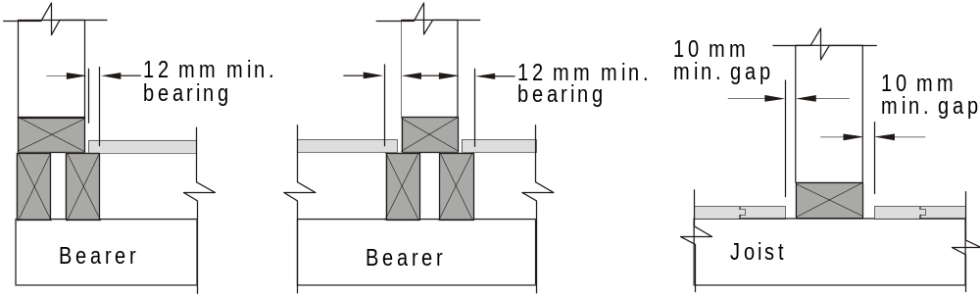
A1
FIGURE 5.1 FITTED FLOORS

Slide 9
5.4 EXPANSION JOINTS
For continuous floor widths over 6 m, measured at right angles to flooring, intermediate expansion joints shall be provided in addition to the perimeter gaps.
This joint shall be either a single 10 mm wide gap, under a wall or across a hallway and the like, or smaller gaps with closer spacings to give an equivalent space (for example, 1 mm gaps at 1 m spacing or loose cramping).

Slide 10
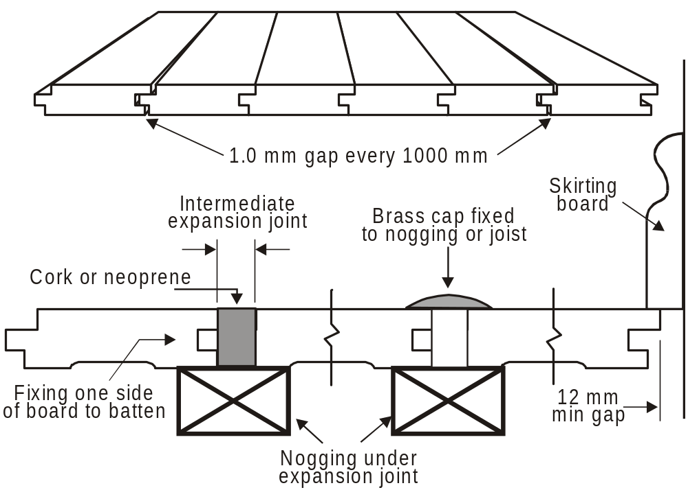
EXPANSION JOINTS

Slide 11
5.5 LAYING AND FIXING
5.5.1 Strip flooring
5.5.1.1 Laying
Fitted flooring shall be kept 10 mm clear of walls or wall plates that are parallel to the length of the boards.
End-matched flooring may be laid with end joints between joists provided that end joints are well distributed and end-matched joints in adjoining boards do not fall within the same joist spacing.

Slide 12
5.5.1.1 Laying
Board lengths shall be at least the equivalent of two joist spacings. Finger-jointed hardwood flooring manufactured in accordance with AS 2796 shall be considered equivalent to continuous strip flooring.
Butt joints shall be cut square and butt-joined tightly together over floor joists. Joints in adjoining boards shall be staggered (see Figure 5.2).

Slide 13
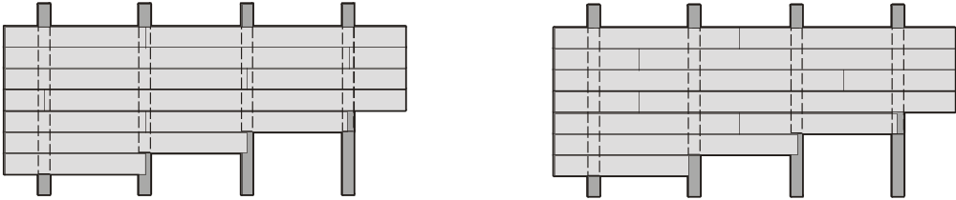
(a) Butt joints over joists —
staggered
(not to occur in adjacent
boards on same joist)
(b) End-matched joints —
staggered
(not to occur in adjacent
boards within same span)
FIGURE 5.2 END JOINTS

Slide 14
5.5.2 Cramping
5.5.2.1 General
Tongues shall be fitted into grooves and boards cramped together ensuring that the boards are bedded firmly on floor joists. Boards shall be in contact with the joists at the time of nailing.

Slide 15
5.5.2.2 Fixing
Boards up to 85 mm cover width shall be fixed by face nailing with one or two nails or shall be secret-nailed with one nail at each joist (see Figure 5.3).
Boards over 85 mm cover width shall be fixed with two nails at each joist.

Slide 16
5.5.2.2 Fixing
Alternate nails in double-nailed boards shall be skewed slightly to the vertical, in opposing directions (see Figure 5.4). The minimum edge distance for nailing at butt joints or board ends shall be 12 mm. aids in reducing splitting.
The nail sizes for flooring up to 21 mm thick shall be as given in Table 5.1.

Slide 17
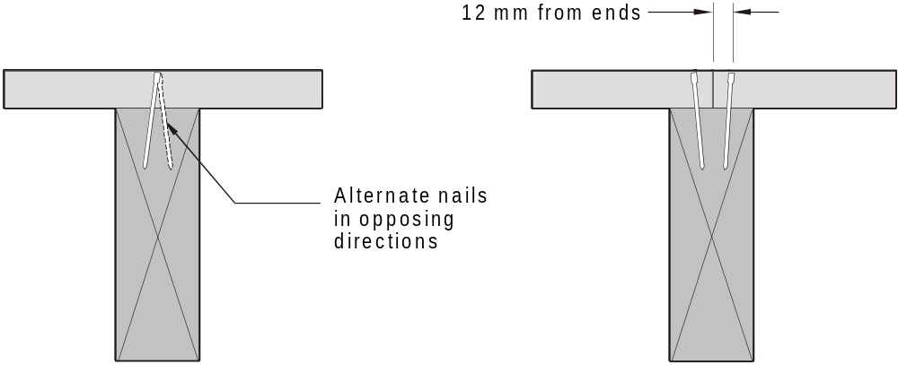
(a) Intermediate joists (b) Butt ends
FIGURE 5.4 FACE NAILING

Slide 18
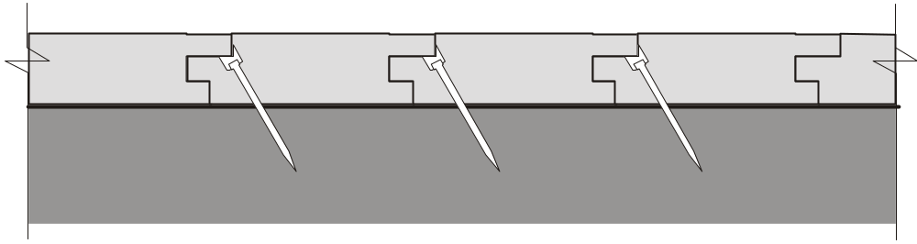
FIGURE 5.3 SECRET NAILING

Slide 19
5.5.2.2 Fixing
NOTES:
1 All nails, including machine-driven nails, should be punched a minimum of 3 mm below the top surface. Nail punching should allow for sanding and finishing and to draw boards tightly onto joists.
2 Pre-drilling boards for fixings at butt ends aids in reducing splitting.

Slide 20
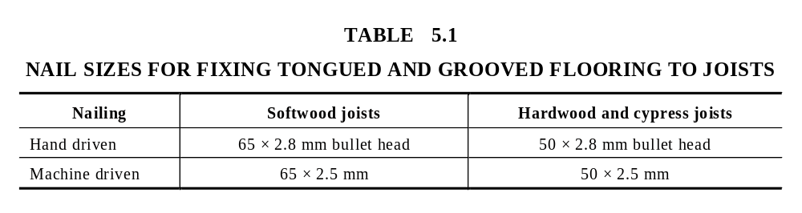

Slide 21
5.5.2.3 Fixing to structural
plywood underlay
Underlay shall be structural plywood to AS/NZS 2269. The thickness shall be determined from Table 5.3 except that it shall be not less than 15 mm thick. Strip flooring shall be face-nailed or secret-nailed to plywood underlay in accordance with Table 5.2. Double face nailing shall be used for boards exceeding 80 mm in width.

Slide 22
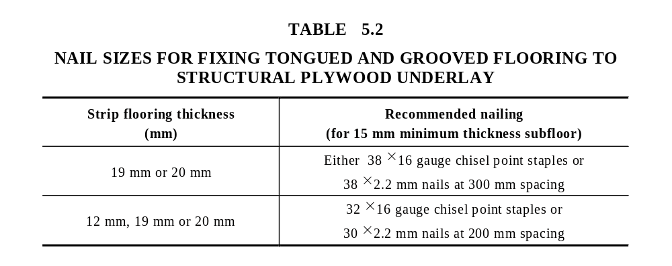

Slide 23
5.5.3 Structural plywood flooring
5.5.3.1 Laying
Plywood panels shall be laid with the face grain of the plies at right angles to the line of the supporting joists and shall be continuous over at least two spans. Ends of sheets shall be butted over joists.

Slide 24
5.5.3.1 Laying
Edges of sheets, unless tongued and grooved, shall be joined over noggings between joists. Noggings shall be of timber not less than 70 × 35 mm section and shall be set flush with the top of the joists.

Slide 25
5.5.3.2 Fixing
Nails used for fixing of plywood shall be either 2.8 mm diameter flathead or bullet-head hand-driven nails, or 2.5 mm diameter machine-driven nails and of length of not less than 2.5 times the thickness of the panel. Nails shall be spaced at 150 mm centres at panel ends and at 300 mm centres at intermediate joists and along noggings. Nails shall be not less than 10 mm from edge of sheets.

Slide 26
5.5.3.2 Fixing
Deformed shank nails shall be used where a resilient floor covering is fixed directly to the plywood.
Structural adhesive or deformed shank nails shall be used where plywood is fixed to unseasoned floor joists of depth greater than 150 mm.

Slide 27
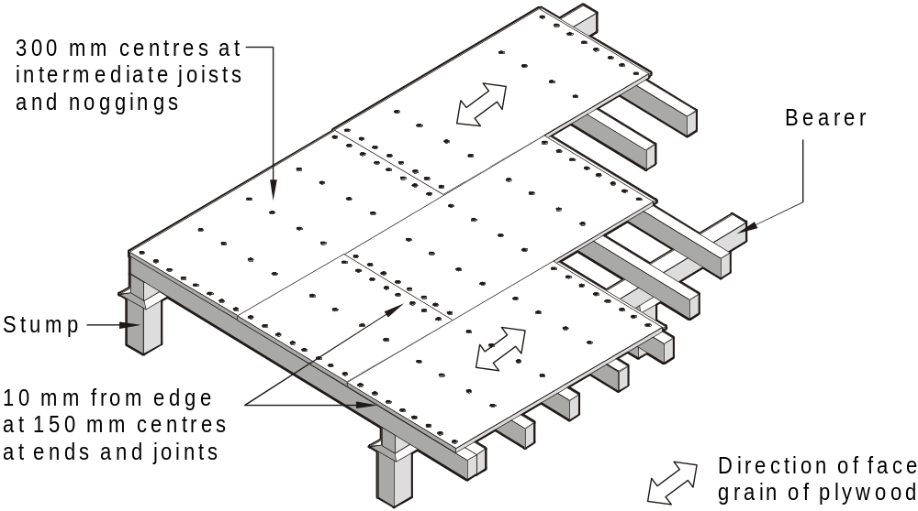
FIGURE 5.5 FIXING OF PLYWOOD SHEET FLOORING

Slide 28
5.5.3.2 Fixing
Where possible, panel ends shall be staggered.
Structural plywood flooring shall not be cramped during installation.
Structural elastomeric adhesive shall be used in a designated wet area.

Slide 29
5.5.4 Particleboard
5.5.4.1 General
Particleboard flooring shall be layed and fixed in accordance with AS 1860.
5.5.4.2 Laying
Sheets shall span not less than two floor joist spacings.
Square edges and ends of sheets shall be butted centrally over joists or on trimmers or blocking.

Slide 30
5.5.4.3 Fixing
Sheets shall be securely glued and nailed to the top edge of the joists. Nails shall be 10 mm from all edges and at 150 mm centres at ends and butt joints for square edge sheets. Nails shall be at 300 mm centres maximum at intermediate joists or nogging.

Slide 31
5.6 WET AREA FLOORS
Timber floors in wet areas (e.g. bathrooms, laundries) shall be protected from moisture in accordance with the Building Code of Australia.

Slide 32
5.7 JOIST SPACING
5.7.1 Flooring
The maximum allowable spacing of supports for tongue and groove strip and sheet flooring shall be in accordance with Table 5.3.
Table 5.3 shall not be used for plywood in which the outer veneers are thinner than any or all of the inner veneers. For plywood sheets supported over one span only, the tabulated spacings shall be reduced by 25%.

Slide 33
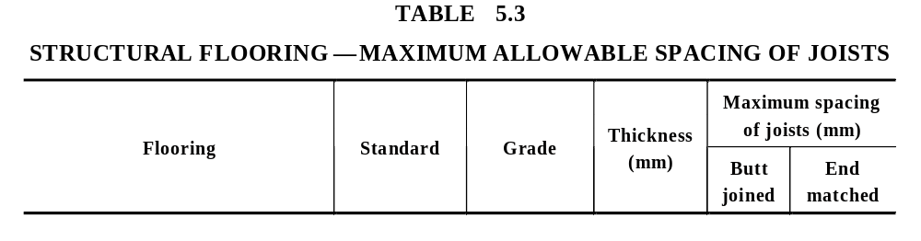
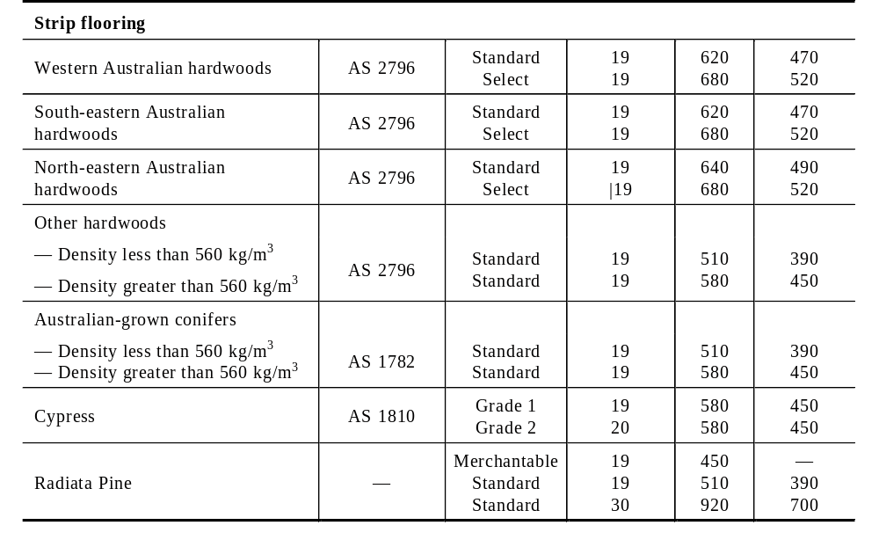

Slide 34
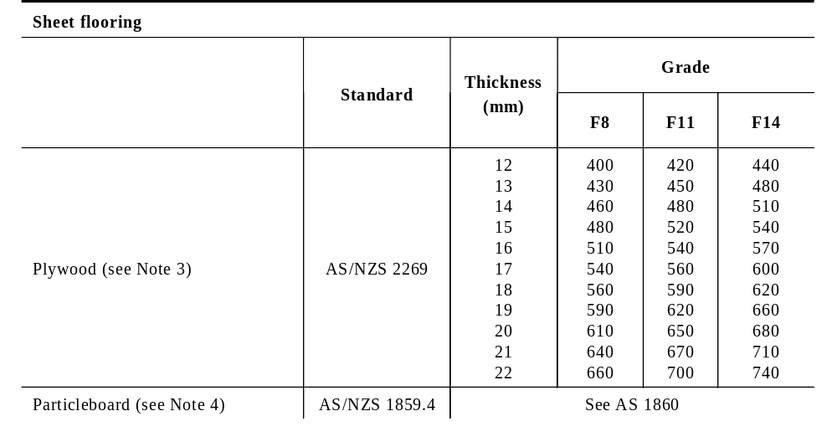

Slide 35
NOTES to Table 8.3:
1 An allowance has been made for light sanding.
2 Strip flooring boards may be regraded after elimination of imperfections by docking.
3 For the plywood flooring thicknesses detailed above, it has been assumed that in any thickness of plywood the veneers are all of equal thickness. For plywood of a given total thickness, the dimensions listed in this Table will be slightly conservative if the outer veneers are thicker than any or all of the inner veneers.
4 For full details on particleboard flooring, see AS 1860.

Slide 36
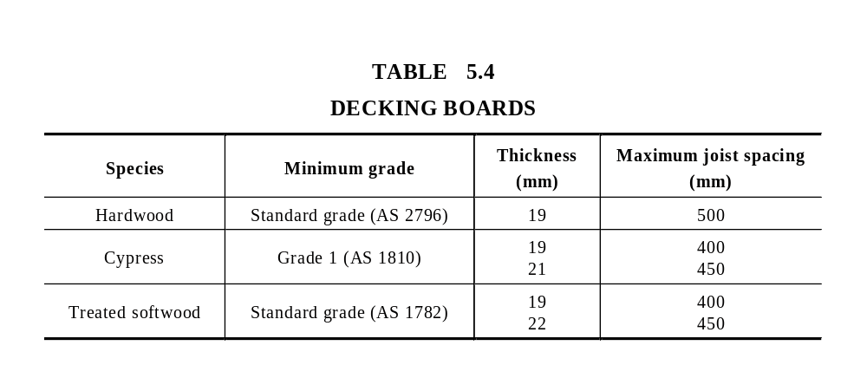
5.7.2 Decking
The maximum allowable spacing of floor joists for timber decking shall be in accordance with Table 5.4 (see also Clause 4.3.1).

